Slide 1
GAA Club Development Grant Scheme
2023

Slide 2
Overall Aim of the Scheme
It is a scheme that funds the development of GAA facilities.
The scheme is targeted towards specific areas of development, namely land purchase, changing rooms, pitch development, hurling walls, floodlighting and so on.
Developments that are funded should have a positive impact on the playing of and participation in our games
General Maintenance is not included as we could not sustain a Development Grant Scheme that contributes to maintenance of over 500 clubs.

Slide 3
Scheme Budget
This year, the budget has yet to be confirmed but should be in the region of €1.5M. The Council will clarify the budget on receipt of applications
The scheme is funded by Central Council and the Munster Council.
Each year, there are between 100 and 150 applications and an average expenditure of over €15M within the province of Munster
Last year was an exceptional year granted the scheme was catering for three years (2020, 2021 & 2022) due to Covid. The association invested €1.8M to clear out the backlog so we can start fresh this year.

Slide 4
Scheme Categories
Category 1 | Land Purchase
Category 2 | Changing Rooms/Clubhouses
Category 3 | Schools
Category 4 | Handball courts
Category 5 | General Development
Category 6 | Property ownership regularisation

Slide 5
Statutory Categories vs Category 5
Categories 1,2,3,4 and 6 are considered as ‘statutory’
These applications are dealt with first and will receive the full grant due
The remaining budget is spent on category 5 and therefore, the level of grant aid depends on the amount available, and the number of applications received.
Usually, the percentage available is between 10% and 15%, 12.5% would be a reasonable forecast for rebates.

Slide 6
Expenditure Ceilings and Max Grant
Category | Max Expenditure | Minimum Expenditure | Max Grant
Category 1: Purchase | €100,000 | €25,000 | 20% or €20,000
Category 2: Changing Rooms/clubhouses | €100,000 | €40,000 | 20% or €20,000
Category 3: Schools | N/A | €20,000 | 15% or €5,000
Category 4: Handball courts | N/A | €20,000 | 15% or €5,000
Category 5A: Floodlighting | €100,000 | €20,000 | 20% or €20,000
Category 5B: Pitch development | €100,000 | €20,000 | 20% or €20,000
Category 5C: Hurling Walls | €75,000 | €20,000 | 20% or €10,000
Category 5D: Ancillary Pitch Facilities | €50,000 | €20,000 | 20% or €10,000
Category 5E: Other Developments | €50,000 | €20,000 | 20% or €10,000
Category 6: Legal aid | N/A | N/A | €700

Slide 7
Category 5 Sub-Categories
Category 5A | Floodlighting of pitches, astroturf pitches and hurling walls. Min spend of €20,000 and min of 300 lux
Category 5B | Pitch development including Astro Turf pitches. It does not include maintenance (e.g.) sanding. Min of €20,000 spend required.
Category 5C | Hurling Walls, including astro turf area associated with it
Category 5D | Ancillary Pitch - goalposts, pitch fencing, scoreboards, gymnasiums etc.
Category 5E | Other developments – car parks, stand etc. Walkways are excluded

Slide 8
Category 6: Property Ownership
This category supports the regularisation of legal ownership of the GAA's property within the province.
The budget for this category is €40,000
The concept is that clubs would receive a €700 contribution towards the legal costs of regularising their property ownership when changing over to the Corporate Trust model. Central Council also offer a separate grant to clubs that go fully Corporate of €1,000.

Slide 9
How to apply
Download scheme guidelines and application forms from the Munster GAA website. Please read the guidelines carefully before making a submission
https://munster.gaa.ie/clubs/munstergaa-development-grants/
Complete application form and provide supporting documents requested such as;
A) Invoices and Bank Statement showing proof of payment.
B) Club deeds which will confirm the trustees are compliant with general rule.
C) Copy of the club’s safety statement and child safe guarding policy.
D) Confirmation of any additional grant aid such as Sport capital funding or County Council grants. (clubs can submit the total expenditure of the project, no club will be penalised for availing of additional grant aid from other sources)
E) The relevant certification is required on all building and electrical works to ensure the works meet industry standards.
Once complete submit the applications to your county board for sign off by the relevant officers before the closing date of Friday 29th of September. Where possible clubs can submit their safety statements, child safeguarding policies & folio details via email to the relevant county officers.
To Qualify
Properties must be vested in the GAA – provide file plan folio of property.
The works must be complete and paid for before submitting an application.
Applications must meet the minimum expenditure threshold to qualify (Expenditure can be accumulated over 3 years).
Cash payments are excluded from the scheme.
Grants will not be paid in the absence of any of the above documentation.

Slide 10
Completing the form
Expenditure can be broken down into the different categories. A separate application form is required for each category application.
E.G Land purchase – C1 €150,000 spent, Floodlighting – 5A €100,000 spent, Pitch Development 5B €100,000 spent & Car Park works – 5E €50,000 spent. These can be submitted as four separate applications.
When completing the form provide details of the invoice and the nature of expenditure;
e.g. ‘Ryan Builders – blockwork for new wall - €12,000
Attach the invoice showing the €12,000 figure
Attach Bank Statement showing the €12,000 payment being made

Slide 11
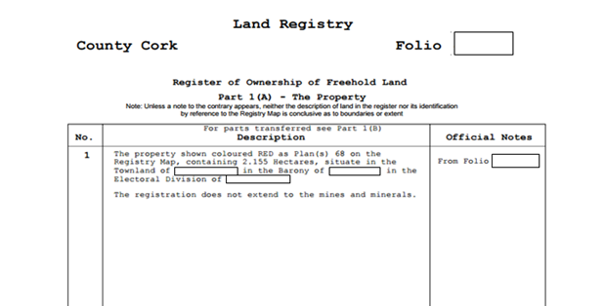
File Plan Folio
The file plan folio is conclusive evidence of title to property (property owners) and any right, privilege or burden appearing thereon.

Slide 12
Relevant County Officers
Clare: Bernard Keane
Cork: Noel O’Callaghan & Joe Blake
Kerry: Diarmuid Ó Sé & Paudie Dineen
Limerick: John Cregan & Jim Barry
Tipperary: Sean Nugent & Andy Hennessy
Waterford: Michael Wadding & Michael Murphy
Munster: John Brennan
Please contact your county board for connection to the officers listed above if you do not already have their contact details.

Slide 13
The process
The closing date for applications to your county board is Friday the 29th of Sept.
The relevant officers will vet the applications in Oct & Nov
The Council will aim to make the announcement of allocations at each county convention in December of this year.
The allocation will be paid by EFT to your club account in December.

Slide 14
Míle Buíochas
Any questions?

